Slide 1
UK Charts Artist Breakdown with Spotify Data
Capstone Project by Miles Mathiason

Slide 2

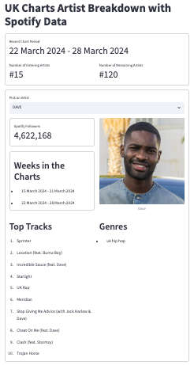
Problem Statement
The goal of this project was to log and create a library of the music artists who have had a song in the UK Charts top 100.
And then, make use of the Spotify Web API to provide extra data on these artists.

Slide 3
Official Charts Website
Python Instance
Spotify Web API
Web Scrape
Requests access token
client_id,
client_secret
Returns access token
Python Script on CRON Job
access_token
API request with access token
access_token
Returns requested data
Psycopg2
JSON object
Pagilla – PostgreSQL DB
Psycopg2
Python Instance on Streamlit Community Cloud
Spotify Web API
Streamlit Web Page

Slide 4
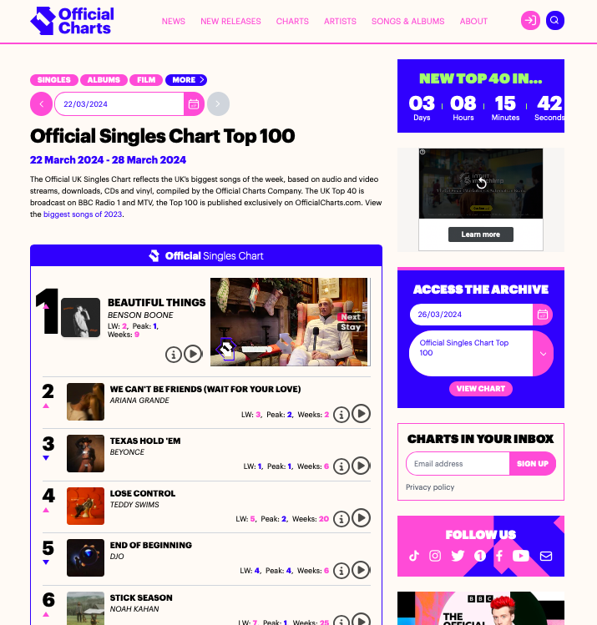
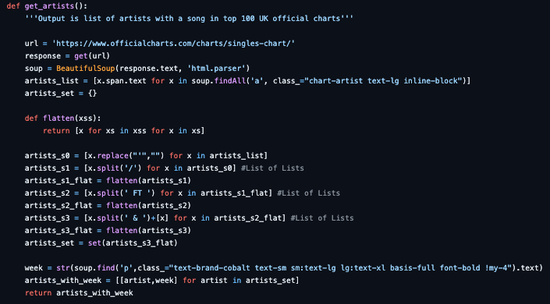
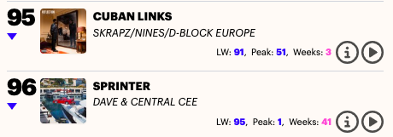
Scraping The Official Charts
BeautifulSoup from bs4 to scrape webpage HTML
String separation using list comprehension: “ FT ”, “ / ”, “ & ”

Slide 5
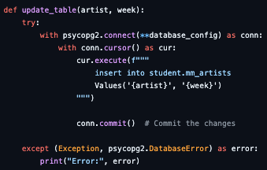
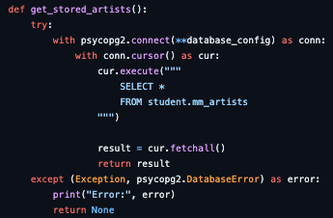
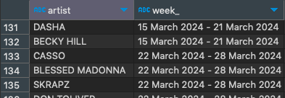

Storage
Data stored on a PostgreSQL database hosted on AWS Cloud. Connected to periodically run python script using psycopg2
Python function to update the table in the database with the artists and chart week
Python function to read the database
If statement to only update the table with data not already entered
Script run periodically through a CRON job on an Amazon EC2 instance
Python function to update the table in the database with the artists and chart week
Python function to read the database
If statement to only update the table with data not already entered

Slide 6
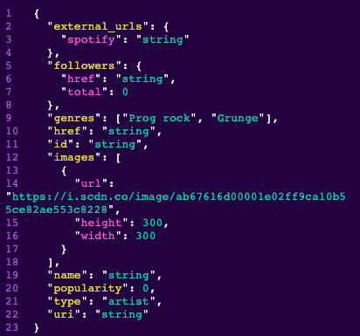
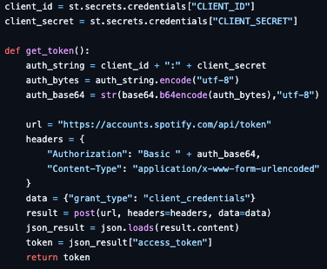
Interacting with Spotify Web API
First, need credentials (client_id and client_secret) to request access_token (valid for 1 hour) which must be contained in the headers of each get request to a Spotify API endpoint
I used st.connection with database credentials stored in ~/.streamlit/secrets.toml to connect to my database
Requests for artist data require an artist id number, so I made a function search_for_artist(token, artist_name) which returned artist id
Then, I could make various API requests e.g. https://api.spotify.com/v1/artists/{id}/top-tracks?country={market}
https://api.spotify.com/v1/artists/{id}

